Slide 1
Convert The PDF To Audiobook With Python
By Aishwarya Kadam

Slide 2
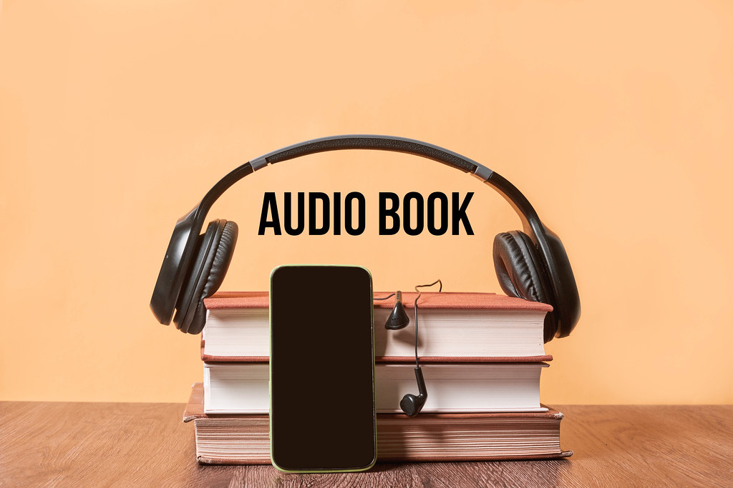
Audiobook
An audiobook is a recording or voiceover of a book or other work read aloud. You can listen to audiobooks on any smartphone, tablet, computer, home speaker system, or in-car entertainment system. In this article, I will walk you through how to create an audiobook with Python.

Slide 3
Tool : Jupyter Notebook
Language : Python
Libraries : pyttsx3 and PyPDF2
Introduction
Data is in : PDF format

Slide 4
Extract the information about the document, such as title, author, etc.
Python libraries are capable for the tasks :
Document division by page
Merge documents per page
Cropping pages
merge multiple pages into one page
encrypt and decrypt PDF files
and more.

Slide 5
PyPDF2 : we will use this library to split the pdf file page by page, then read the text on each page, then send the text to the next step in the process to create an audiobook with Python.
Libraries
pyttsx3 : this library is capable of converting text to speech offline. The text that we read from a pdf is then fed as an input to the text-to-speech engine

Slide 6
Libraries installations:
!pip install PyPDF2
# PyPDF2 allows manipulation of pdf in memory.
!pip install pyttsx3
#The pyttsx3 library is capable of converting text to speech offline
! pip install gTTS
code :

Slide 7
import PyPDF2
from gtts import gTTS
import os
# Open the PDF file in read-binary mode
pdf_file = open('file1.pdf', 'rb')
pdfReader = PyPDF2.PdfReader(pdf_file)
# Initialize text-to-speech engine
speaker_text = '' # Initialize an empty string to store the extracted text
code :

Slide 8
The next step in the process is to loop the process for each page of the pdf file and stop the pyttsx3 speaker engine last
code :
# Iterate through each page of the PDF
for page_num in range(len(pdfReader.pages)):
page = pdfReader.pages[page_num]
text = page.extract_text()
# Add extracted text to the speaker_text
speaker_text += text
# Close the PDF file
pdf_file.close()

Slide 9
# Check if extracted text is empty if not speaker_text.strip(): print("No text found in the PDF.") else: # Initialize gTTS with the accumulated text speaker = gTTS(text=speaker_text) # Save the audio to an MP3 file audio_file = 'audio1.mp3' speaker.save(audio_file) # Play the audio os.system(f"start {audio_file}") # This command works on Windows, adjust for other OS
code :

Slide 10
code:
The next step is to save the audio as mp3 file :
# Save the audio to an MP3 file
audio_file = 'audio1.mp3'
speaker.save(audio_file)
# Play the audio
os.system(f"start {audio_file}")
# This command works on Windows, adjust for other OS

Slide 11
Thank You !
Reference: https://thecleverprogrammer.com/2020/10/22/create-an-audiobook-with-python/

